Slide 1
Cyclistic bike-share analysis case study
By Keiran Morris – email: k_lm@hotmail.co.uk

Slide 2
Objective Introduction
Objectives
Understanding how casual riders and annual members use Cyclistic bikes differently
Create a marketing strategy to convert casual riders into annual member
Classifications
Casual members who we will refer to as Casuals, are Customers who purchase single-ride or full-day passes an o not have annual memberships.
Cyclistic members who we will refer to as Members, are Customers who purchase annual memberships

Slide 3
History of the Company
In 2016, Cyclistic launched a successful bike-share offering. Since then, the program has grown to a fleet of 5,824 bicycles that are geotracked and locked into a network of 692 stations across Chicago.
The bikes can be unlocked from one station and returned to any other station in the system anytime.

Slide 4
Main Findings
4,877,783 RIDES THAT TOOK PLACE
THERE WERE 197,427 CASUAL RIDES
THERE WERE 290,3512 MEMBER RIDES

Slide 5
Number Of Rides Per Category
Classic Bikes : 1,064 ,04 4
Docked Bikes : 175 ,924
Electric Bikes :2,076,711

Slide 6
Number Of Rides Per Hour
For Casuals and Members, the number of rides increases from midnight and peaks at 17:00 hours.

Slide 7
Number Of Rides Per Season
For Casuals and Members, the number of rides were the most in summer an the lowest at Winter

Slide 8
Percentage Of Weekday & Weekend Rides
Casual riders
Member Riders
For Casuals and Members, there were more rides on Weekdays than on Weekends.
Casuals use bikes more on the weekend than Members

Slide 9
Number Of Rides Per Day
Casuals have the most ries Friay to Sunay peaking on Saturay.
Members have the most ries Tuesay to Thursay

Slide 10
Percentage Of Rides Per Day
Casual riders
Saturday has the most rides with 16%.
Monday has the least rides with 13%
There is a small 3% range between days

Slide 11
Number Of Rides Per Month
Casuals ride the most in July 342,307
Members ride the most in August 360,719

Slide 12
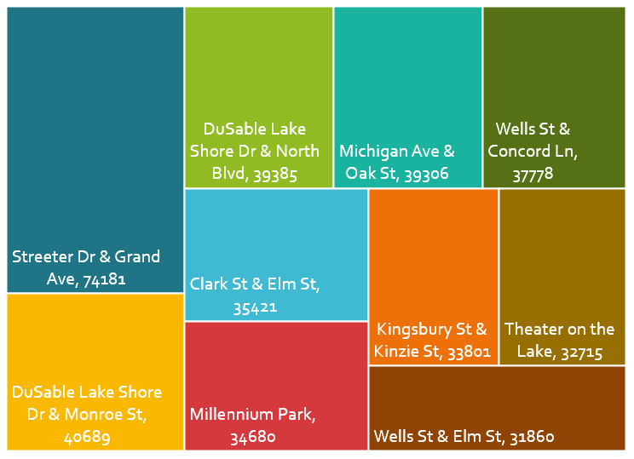
Top 10 Popular Stations
Most popular: Streeter drive & Gran Avenue
With a total: 74,181

Slide 13
Marketing Strategy: To convert casual riders into annual member
Most important factor is to focus advertising on Casuals
Focus advertising on electric bikes
Improve safety
Invest financially in the marketing campaign the most between June an August
Discount single ride passes from 1400 to 1900 on Fridays to Sunday
Discount full day passes on Fridays to Sunday
Physical advertisements of the campaign close to the top popular stations
Local business partnerships close to the most popular stations
A new package possibility is weekend annual membership

